Slide 1
Algebraic Fractions
EQ – How do you add and subtract algebraic fractions?
Mrs James
Year 10

Slide 2

Learning Intentions
Students will be able to
Define algebraic fractions
Add and subtract algebraic fractions
WICOR

Slide 3
24
7
30
Algebraic Fractions
Date:
EQ – How do you add and subtract algebraic fractions?
Algebraic fractions are fractions that involve algebraic expressions, rather than only numbers.
The algebraic part may be in the denominator or numerator.
REMEMBER: Algebraic fractions are added, subtracted, multiplied and divided in the same way as ordinary fractions.
Question
JIGSAW ACTIVITY (Groups of 4) on how to + - × and ÷ fractions

Slide 4
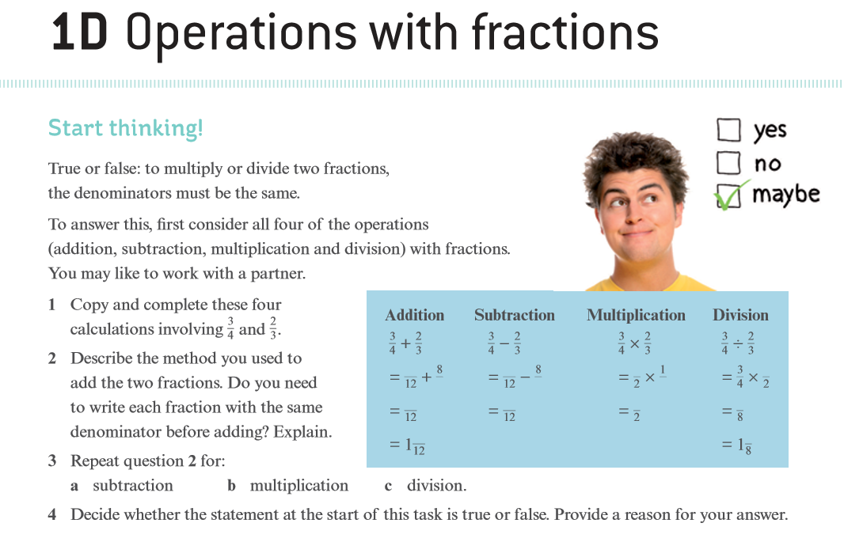
Notes:
JIGSAW Activity
Students in groups of 4
12mins
1 student will complete Q1, 2 for the addition
1 student will complete Q1, 2 for the subtraction
1 student will complete Q1, 2 for the multiplication
1 student will complete Q1, 2 for the division
Students come back into their groups
12mins
-Each student has 3 mins to tell their group what they came up with for Q 2 and 4
Finally in their groups students are to discuss Q 4 and write a summary statement
Then ask the students what operations involving mixed numbers

Slide 5
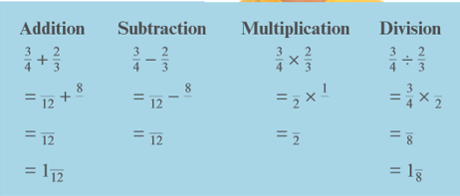
Notes:
JIGSAW Activity
Students in groups of 4
12mins
1 student will complete Q1, 2 for the addition
1 student will complete Q1, 2 for the subtraction
1 student will complete Q1, 2 for the multiplication
1 student will complete Q1, 2 for the division
Students come back into their groups
12mins
-Each student has 3 mins to tell their group what they came up with for Q 2 and 4
Finally in their groups students are to discuss Q 4 and write a summary statement
Then ask the students what operations involving mixed numbers

Slide 6
24
7
30
Algebraic Fractions
Date:
EQ – How do you add and subtract algebraic fractions?
Adding and subtracting algebraic fractions
When adding and subtracting fractions, you must use a common denominator.
You should use the lowest common denominator (LCD).
Question

Slide 7


Slide 8
Practice
Nelson WA Maths 10
Example 18ab-20 p103-104

Slide 9
Task
algebraic fractions add/subtract
differentiated practice worksheets with space for answers.
You will get another lesson to work independently on this.
solutions included
Remember “PEOPLE MATTER” and the 100% rule

